Slide 1
Attempting a Prophet Forecast on Covid Vaccination Uptake Data

Slide 2
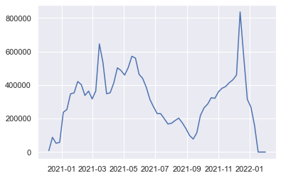

Weekly Uptake Figures from Excel Tool
This initial time series was created from the data held in the Excel-based Demand and Capacity modelling tool, covering all 1st dose, 2nd dose and first booster vaccination uptake.

Slide 3
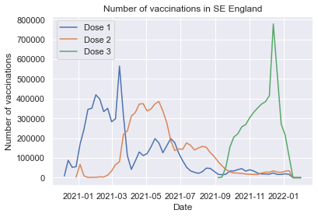

Weekly Uptake Figures by Dose
This time, the total has been split by dose. Note that Dose 3 is the 1st Booster. The first booster was the latest dose to be administered at the time.
This chart highlights the fact that uptake is not really seasonal, uptake is more driven by vaccination rollout (as each dose becomes available to more JCVI cohorts) and by vaccination campaigns (for example, the spike in December 2021 was a drive to get as many people as possible vaccinated with their booster ahead of Christmas.

Slide 4
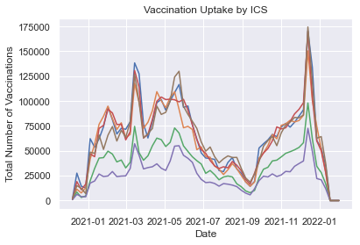
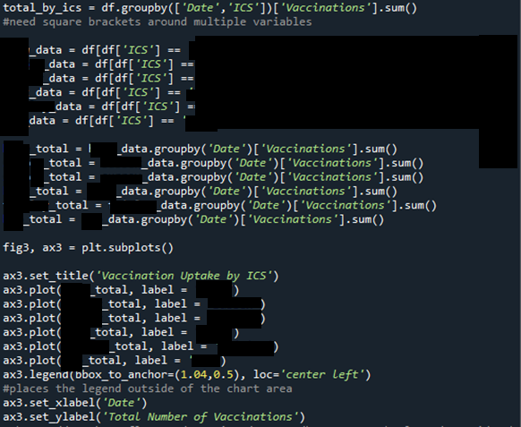
Weekly Vaccination Uptake Split by ICS
Each System exhibits similar uptake pattern.

Slide 5

Value Error returned using Weekly Uptake figures
ValueError: x must have 2 complete cycles requires 104 observations. X only has 61 observations.
Weekly data held in the Excel-based tool could not be used, because there weren’t enough data points to form a time series upon which seasonal decomposition could be performed.
The error seems to suggest that a minimum period of two years is required to produce a time series that can be analysed for seasonality using weekly data (104 observations = 104 weeks).
Using seasonal_decompose from statsmodels

Slide 6
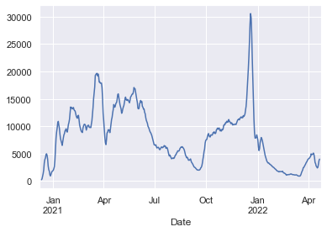
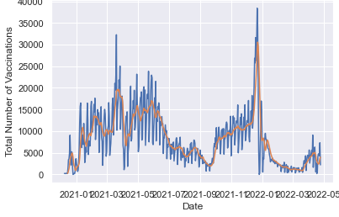
Using Daily Uptake Figures for one system only
Daily total with 7-day
Since the existing dataset of weekly data did not exhibit seasonality and was therefore not suitable for producing a forecast, daily data was extracted from NHS Foundry (source of vaccination activity) directly.
Seasonal decomposition
However, seasonality is still not in evidence using the daily data.
Note that the seasonal decomposition closely resembles the 7-day moving average.

Slide 7
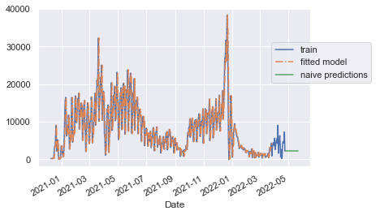
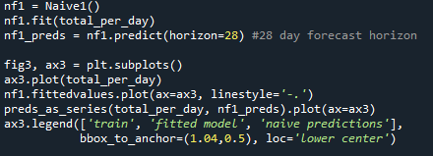
Following the Forecasting Lecture Notes – Naïve Predictions
Although it was unlikely to produce any useful insights, each technique covered in the lecture activities was implemented using the daily vaccination uptake data.
Naïve predictions.

Slide 8
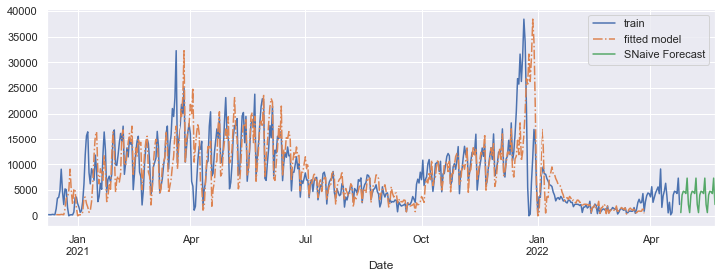
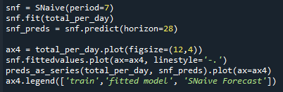
Following the Forecasting Lecture Notes – Seasonal Naïve Forecast
Seasonal naïve forecast.
Notes:
snf = SNaive(period=7)
snf.fit(total_per_day)
snf_preds = snf.predict(horizon=28)

Slide 9
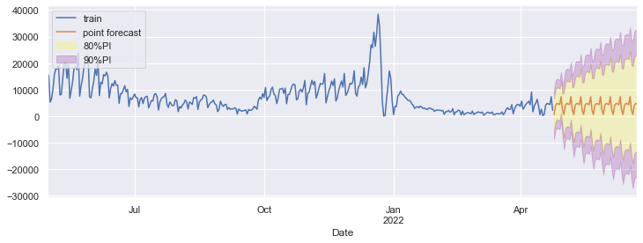
Seasonal Naïve Forecast With Prediction Intervals
Prediction Intervals
Notes:
{'me': 3079.9285714285716,
'mae': 3171.4285714285716,
'mse': 13181700.785714285,
'rmse': 3630.6612050306053,
'mape': 84.51940146573367,
'smape': 120.14395579834313}

Slide 10
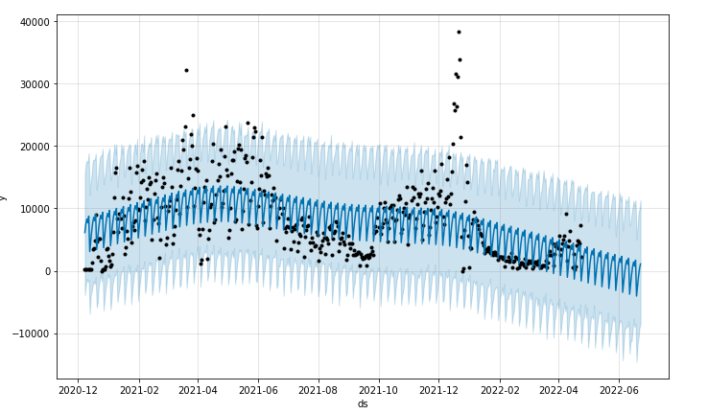
Forecasting With Prophet
Since there is no real seasonality over the time period in question, Prophet has only been able to vaguely pick out the general trend, which can be seen in the downward curve of the blue forecast-related plots. Prophet has only managed to fit itself to the weekday trend and has used that to make the forecast. See the next slide for Prophet’s decompositions.

Slide 11
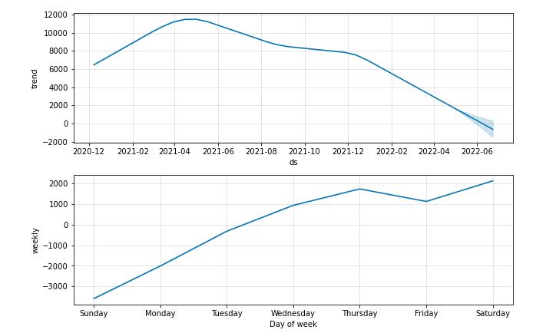
Seasonality Trend Analysis With Prophet
General trend over the time period identified by Prophet.
Day of week analysis could actually be useful. Perhaps try to incentivise attendances for jabs on different days to spread out demand on resources over the week. Could be useful to understand for ordering vaccine doses.

Slide 12
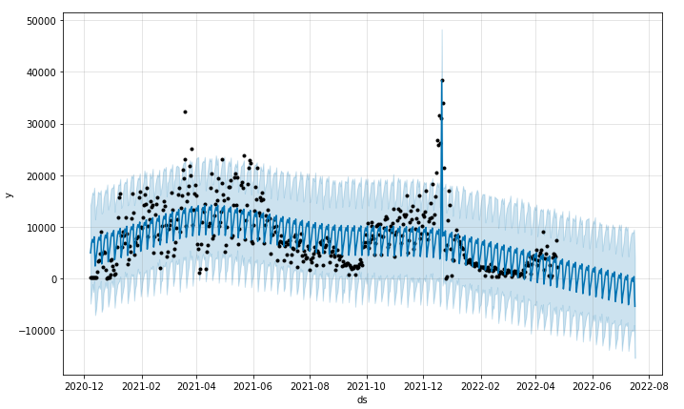
Adding a “Holiday” With Prophet
A “holiday” was added with Prophet. It corresponds to the date when there was a massive pre-Christmas 2021 drive for people to get a booster vaccination. It correlates with the high actual figures.

Slide 13
Conclusion
Not enough data points to see seasonality. In the first few years demand is all down to vaccine rollout. In the future we may see seasonality with annual booster uptake.
It might be better to produce a vaccine uptake modelling tool that models uptake under various potential scenarios, rather than using forecasting techniques.

